Slide 1
Set Extension Project
Enzo Poropat and Sarah Smeltzer

Slide 2
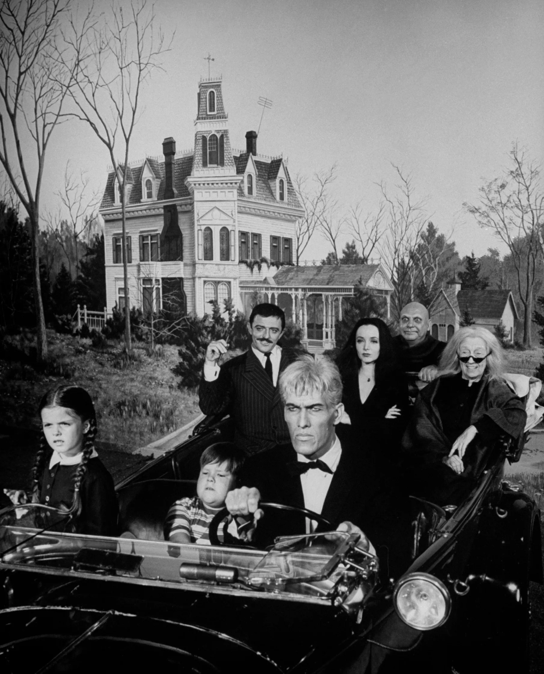
Original Image
The Addams Family
1964 TV series

Slide 3
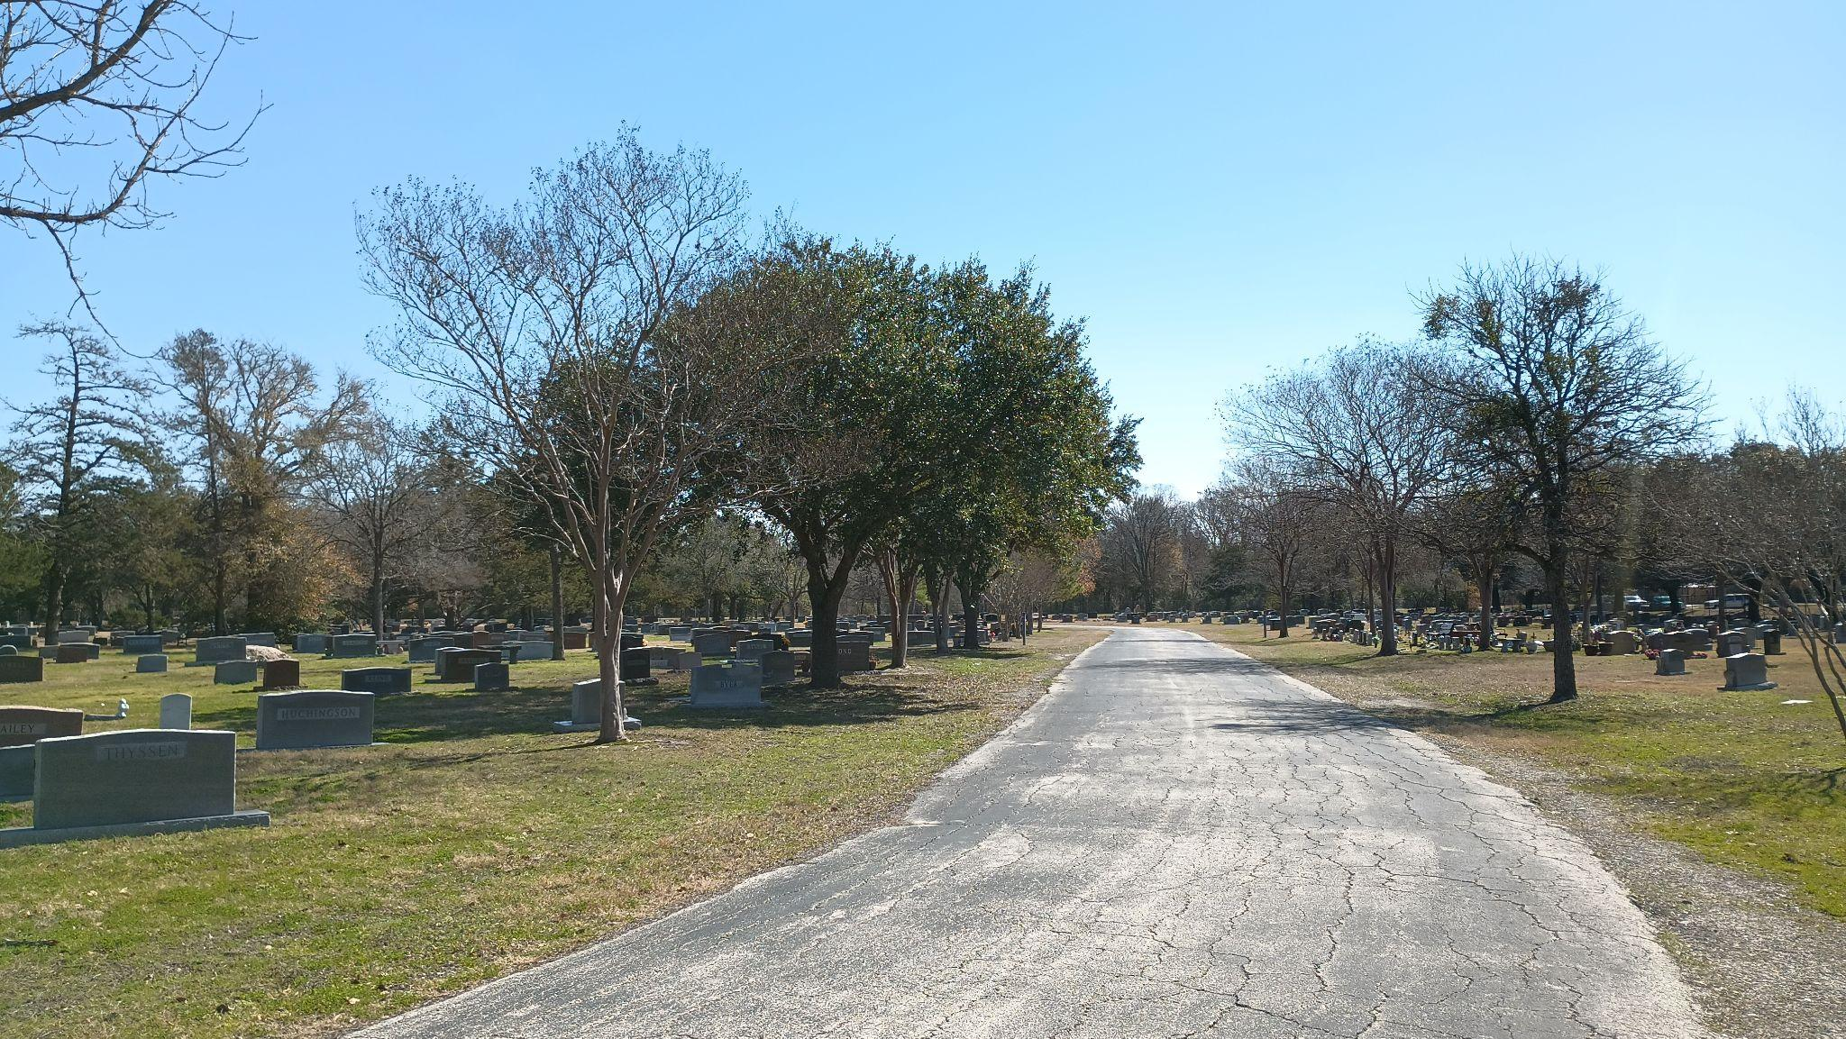
Background
College Station City Cemetery

Slide 4
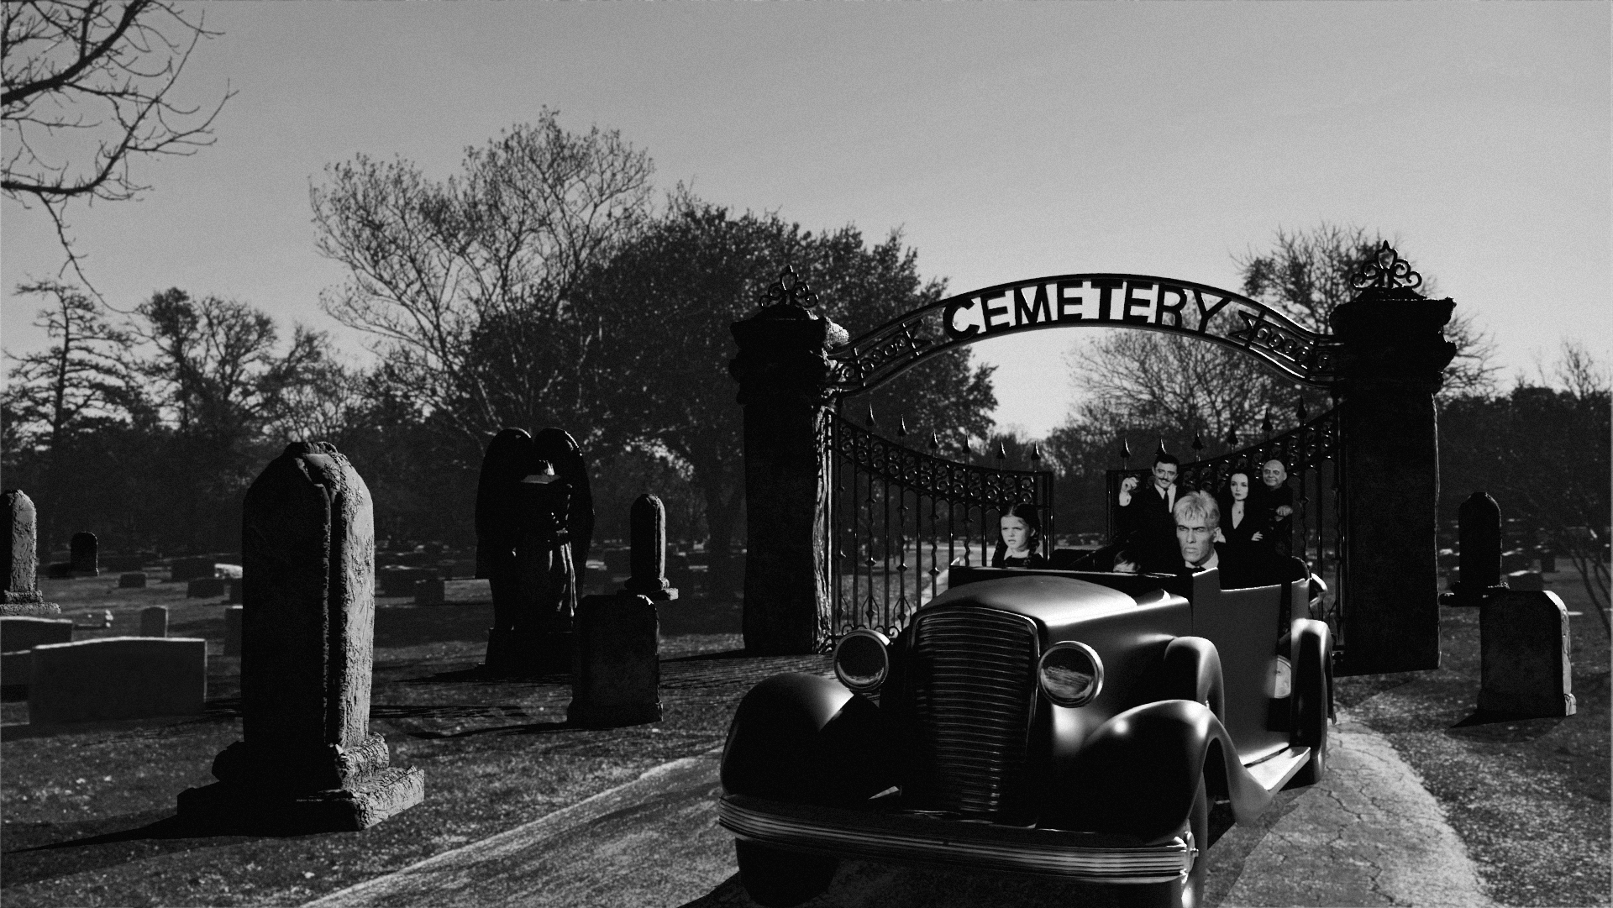
Final Image

Slide 5
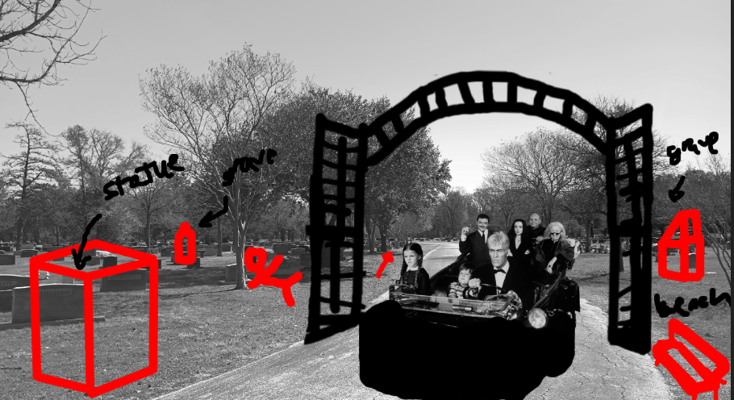
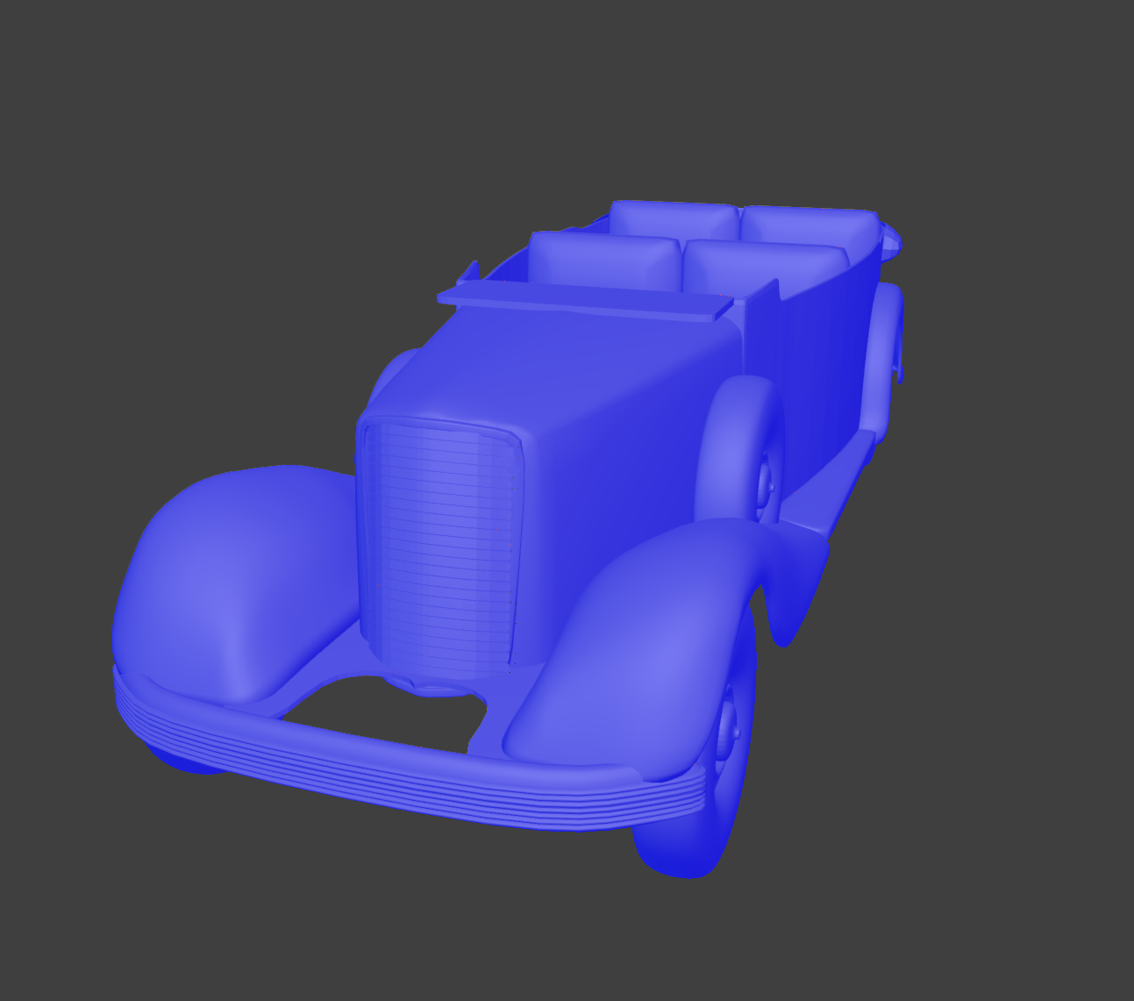
Steps
Develop Concept
Choose B&W image and background location
Sketch idea
Prepare Assets
Take background images and choose the best one
Edit Background Image to match original image
Create 3D models: Graves, Car, Gate and Statue

Slide 6
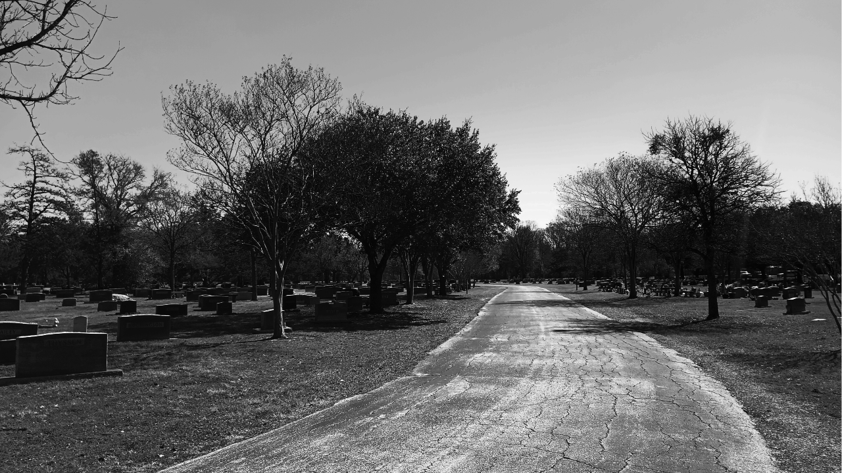
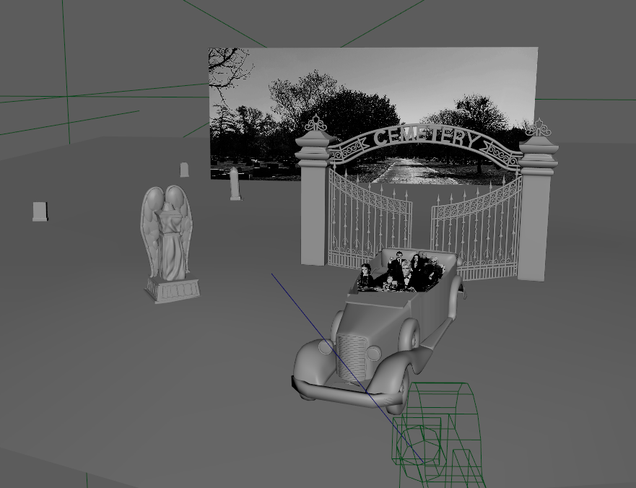
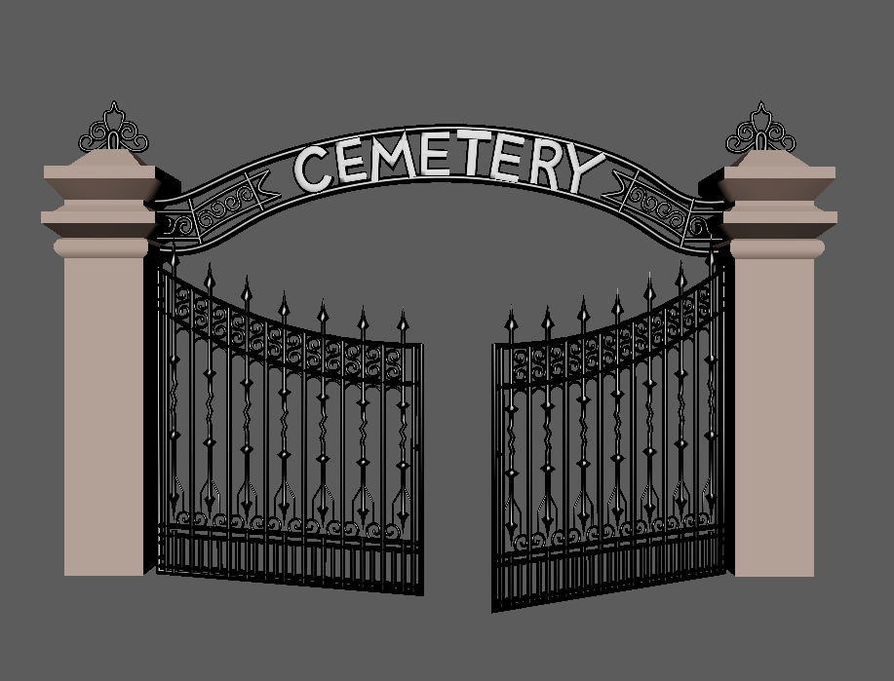
Steps
Put it all together
Place everything into Maya, get final image
Final touches in Photoshop

